Slide 1
Cascading Style Sheets (CSS)
So named because CSS gives your web pages some style!
Cascading because style rules override each other
Great tool for making web-pages more usable.

Slide 2
Simple example of CSS
<table>
<tr><td>text in black and</td></tr>
<tr><td style="color:#0000FF">blue</td></tr>
</table>

Slide 3
Changing the colors
Colors are (usually) written as six hexadecimal digits indicating the amount of red, the amount of green, and the amount of blue (on a scale of 0 through 255, or 00 through FF).
So #FFA030 would mean:
Maximum red (FF)
A fair amount of green (A0)
A dash of blue (30)
The result is an orange color.

Slide 4
Changing background colors
Text in black and
<span style="color:#0000FF;background-color:#FFa030">blue</span>
<div style="background-color:#ff0000">for comparison</div>
You can set lots of style attributes; just separate them with semicolons. Notice how the div tag is a block all the way across from left to right.

Slide 5
Changing the font
Ugly old-school newspaper font
<span style="font-family:sans-serif">vs more web-friendly sans-serif font</span>
Set the font family to sans-serif to get rid of that horribly ugly font (usually Times Roman) in most browsers.
"Serifs" are those little curly cues on the letters of Times New Roman. They are supposed to help people read large amounts of text. Most web pages use sans-serif fonts.

Slide 6
Bolding text, controlling size
<div style="font-family:sans-serif; font-weight:bold; font-size: 16pt">Big 'n bold</div>
These days, most reputable web developers prefer CSS "font-weight:bold" instead of <b>.Tags like <b>, <strong> are used to show the importance of a word in a sentence.

Slide 7
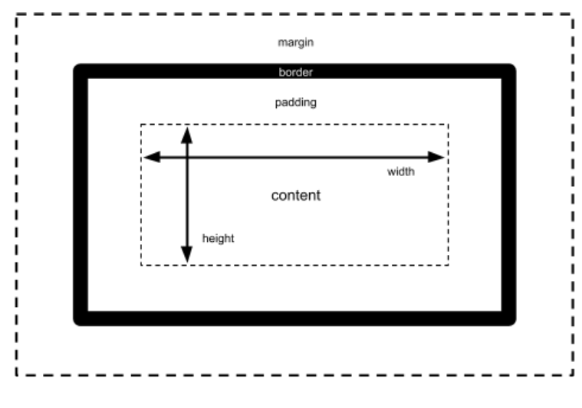
The box model
Every element in an HTML document is structured as a many-layered box:

Slide 8
Changing the border
<div style="border: 2px solid #00FF00">Text with a border</div>
You can draw a border around elements, also. Experiment. See what happens when you change "2px" to "5px". Then see what happens if you change your 5px border from "solid" to "inset" or "outset".
Tip: You can edit the HTML in the browser. Right-click->inspect->right-click on Elements->Edit as HTML

Slide 9
Changing the padding
<div style="border: 2px solid #00FF00; padding: 20px 10px 5px 0px">Text with a border</div>
This pads 20px of space above the text but inside the border, 10px of space to the right inside the border, 5px of space below the text inside the border, and 0px of space to the left.

Slide 10
Changing the margins
<div style="border: 2px solid #00FF00; margin: 20px 10px 5px 0px">Text with a border</div>
This adds 20px of space above the text and outside the border, 10px of space to the right outside the border, 5px of space below the text outside the border, and 0px of space to the left.
(Margin does not work well with span. Span is not a block. It's just a little region of text.)

Slide 11
You can style just about any tag
<table style="border: 1px solid black; background-color:#ffffaa">
<tr><td style="font-weight:bold">Name</td>
<td style="font-weight:bold">Children</td></tr>
<tr><td>Eddie</td><td><ul>
<li style="color:#808080">Alice</li>
<li style="color:#808080">Bob</li>
</ul></td></tr>
<tr><td>Esteban</td><td><ul>
<li style="color:#808080">Carmen</li>
<li style="color:#808080">Daniela</li>
</tr>
</table>

Slide 12
That gets wordy if we have many rows
You can assign a certain style to many elements all at the same time.
Just give them a "class" attribute
And create a <style> tag telling what style to apply to elements of that class
<style>.myclassname {color:#f03366;font-family:Arial}</style>

Slide 13
No need to repeatedly type font-weight: bold and color:#808080
<style>
.hdr { font-weight: bold; }
.kid { color: #808080; }
</style>
<table style="border: 1px solid black; background-color:#ffffaa">
<tr><td class="hdr">Name</td>
<td class="hdr">Children</td></tr>
<tr><td>Eddie</td><td><ul>
<li class="kid">Alice</li>
<li class="kid">Bob</li>
</ul></td></tr>
<tr><td>Esteban</td><td><ul>
<li class="kid">Carmen</li>
<li class="kid">Daniela</li>
</tr>
</table>

Slide 14
Or you can select based on tag name
<style>
table {border: 1px solid black; background-color:#ffffaa;}
th { font-weight: bold; }
li { color: #808080; }
</style>
<table>
<tr><th>Name</th> <th>Children</th></tr>
<tr><td>Eddie</td><td><ul>
<li>Alice</li>
<li>Bob</li>
</ul></td></tr>
<tr><td>Esteban</td><td><ul>
<li>Carmen</li>
<li>Daniela</li>
</tr>
</table>

Slide 15
You can modify a few selected tags at once
<style>
body, th, td, li { font-family: sans-serif }
table {border: 1px solid black; background-color:#ffffaa;}
th { font-weight: bold; }
li { color: #808080; }
</style>
<table>
<tr><th>Name</th> <th>Children</th></tr>
<tr><td>Eddie</td><td><ul>
<li>Alice</li>
<li>Bob</li>
</ul></td></tr>
<tr><td>Esteban</td><td><ul>
<li>Carmen</li>
<li>Daniela</li>
</tr>
</table>

Slide 16
You can select tags based on nesting
<style>
body, th, td, li { font-family: sans-serif }
table {border: 1px solid black; background-color:#ffffaa;}
th { font-weight: bold; }
table tr li { color: #808080; }
</style>
<table>
<tr><th>Name</th> <th>Children</th></tr>
<tr><td>Eddie</td><td><ul>
<li>Alice</li>
<li>Bob</li>
</ul></td></tr>
<tr><td>Esteban</td><td><ul>
<li>Carmen</li>
<li>Daniela</li>
</tr>
</table>

Slide 17
ID Selectors
You can also apply an id attribute to any HTML element and then use it in CSS selectors.
The id value is used in a selector by prepending a #.
Here’s an example of an id being used to style an element: <div id="main-content"> ... </div> #main-content { margin: 20px; }

Slide 18
Combinators
There are few different ways where we can combine elements to apply style:
AB – any element matching both A and B at the same time, e.g.:
p.user-address
A B – any element matching B that is a descendent of an element matching A, e.g.:
p em
A > B – any element matching B that is a direct child of an element matching A, e.g.:
ul > li
A + B – any element matching B that is the next sibling of an element matching A, e.g.:
.nav-header + .nav-item

Slide 19
You can even reuse CSS across files
body, th, td, li { font-family: sans-serif }
table {border: 1px solid black; background-color:#ffffaa;}
th { font-weight: bold; }
table tr li { color: #808080; }
#thiskidisbadnews {color: #FF0000; font-size: 16pt;}
Put this in style.css
<html>
<head>
<link rel="stylesheet" type="text/css" href="style.css">
</head>
</html>
Put this in your HTML file

Slide 20
Positioning
We can control the position of an HTML element using the CSS position property.
position lets us control the type of positioning.
The top, right, bottom, and left properties let us specify the actual position.
We refer to an element as positioned if its position property value is relative, absolute, or fixed.

Slide 21
Activity
Open up the directory where you have created navbar HTML file.
Let’s add CSS to it from the styles.css on Canvas

Slide 22
Cascading rules: very complicated
In general…
Later rules overrule earlier rules
So rules in the HTML file override rules in the <style> tags
And rules in the <style> tags override rules in the linked stylesheet file
And stylesheet files specified later in the HEAD will override those specified earlier in the HEAD
And rules associated with id override rules associated with class
And rules associated with class override rules associated with tags
And some rules (though not all) are inherited by default depending on how tags are nested inside one another
And that's not even taking into account advanced CSS rules such as media selectors and @import, which we will cover later in this course

Slide 23
Yikes!
First of all, as much as possible, keep it simple.
Try to use only a single .css file
Try to select based on tag name and class name instead of selecting based on id
Try not to put style into tags directly
Second, test your page in a browser that can explain to you how rules override each other.
Such as Google Chrome

